Slide 1
Project Walknet: Making cities accessible to everyone
Andrew Abbott, Alex Deshowitz, Dennis Murray
November 17, 2017

Slide 2
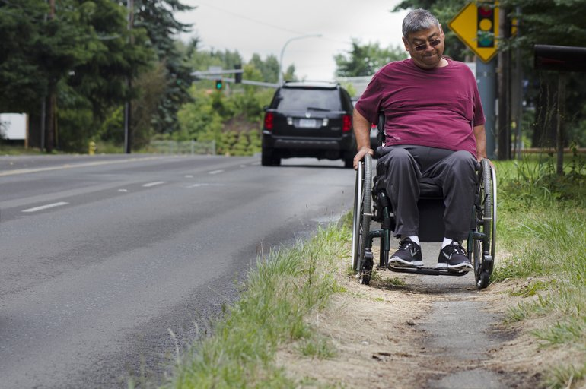
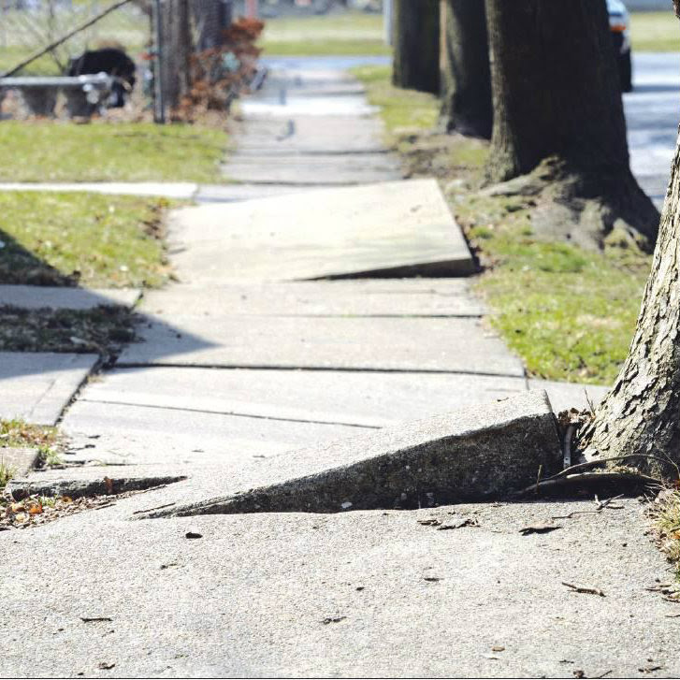
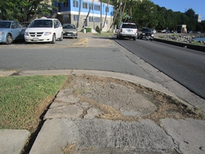
The problem It is estimated that every major metroplex in the United States has large areas which are either inaccessible or provide challenges to the disabled
Sidewalks remain the single most used means of transportation for those who are mobility challenged
Only 17.4% of working-age wheelchair users are employed
This means that many of those bound to wheelchairs do not have the ability to purchase other modes of transportation and rely heavily on sidewalks
In many cases, sidewalks are their only path to get where they need to go
For many municipalities the process of sidewalk assessment is a painstaking process that involves subjective assessment

Slide 3

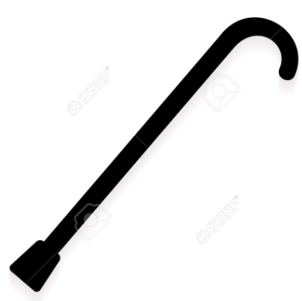



This problem isn’t going away Each year, approximately 2 million new users adopt wheelchairs as their primary mode of mobility and ambulatory disabilities are the largest portion of total disabilities
As baby boomers continue to age the rate of increase in the population of wheel chair users will continue to rise
Ambulatory disabilities continue to be both the fastest growing and the largest portion of total disabilities in the country
6.7% of the U.S. population
+ 2 Million people each year

Slide 4


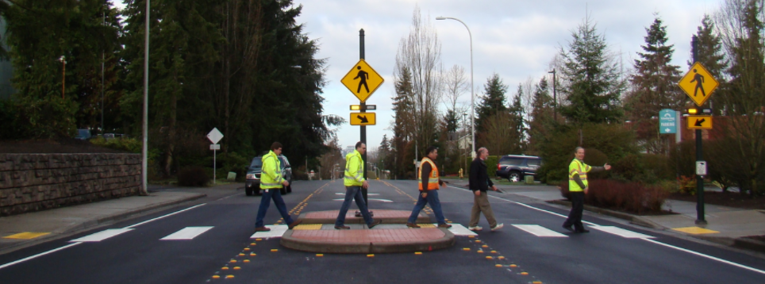
…And it doesn’t just impact the mobility impaired In 2015, 5,376 pedestrians and 818 bicyclists were killed in crashes with motor vehicles, representing approximately 18% of the total traffic fatalities in that year
While total traffic fatalities have been on the decline for several years, pedestrian fatalities increased by 12 percent between 2006 and 2015 and continue to rise
The number of pedestrians killed in 2015 was the highest this statistic has been since 1996
An estimated 70,000 pedestrians were also injured in vehicle wrecks in 2015
Providing better curb cut designations and crosswalks in the correct places with better visibility could have potentially mitigated these deaths
5,376 pedestrians
818 bicyclists
Better sidewalks = lives saved

Slide 5


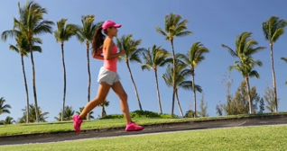
…poor sidewalk quality also carries health ramifications The CDC states that inaccessible or nonexistent sidewalks have been linked the sedentary habits that are growing at an alarming rate in the U.S.
The sedentary habits and lifestyles of Americans is nothing short of an epidemic
A lack of physical activity leads to diseases such as obesity, cardiovascular disease, diabetes, and even cancer
If the small price of building sidewalks has the ability to offset skyrocketing medical costs and death, shouldn’t we as a society invest in ourselves?
9.4% of the population
1.5M new cases/year
#1 killer of Americans: heart disease
Better sidewalks = healthy living

Slide 6

This begs the question: why we aren’t doing more today? If there are so many ramifications to having poor sidewalk and curb cut infrastructure, why aren’t we doing more?
If poor sidewalks =
Inaccessibility
Hazards
Health risk
What are we doing to solve the problem?

Slide 7
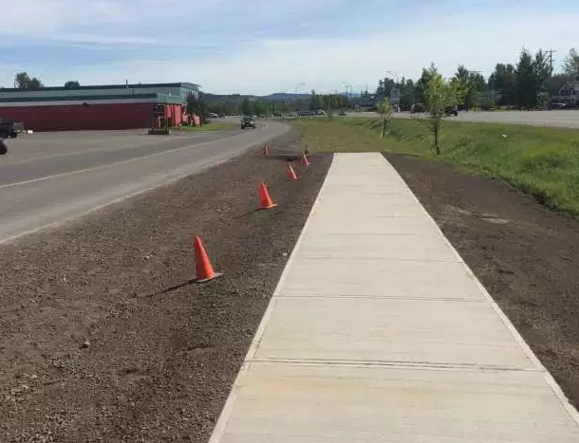
American recovery and Reinvestment Act In 2009, this $831B program that carved out over $100B for infrastructure improvement, but many dubbed the outcome as the “sidewalk to nowhere”
The program’s heart was in the right place, but implementation was poor

Slide 8

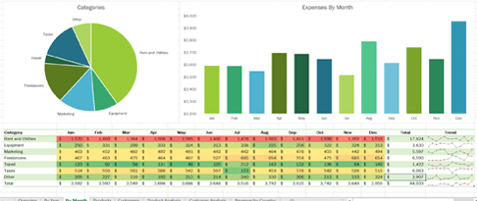
Identifying the right places to build The program failed because today,municipalities rely on word of mouth or expensive contractors using excel spreadsheets to identify sidewalk projects
Today, $ are allocated via:
This approach is neither efficient nor accurate
This approach also allows for the introduction of spending bias
The loudest voice in the room tends to get the infrastructure dollars, resulting in a high level of subjectivity
Or
Excel
Complaints

Slide 9
20 slides total
A total of 20 slides are allowed for content for a total presentation time of 5 minutes

Slide 10
Slide Format
This is a generic slide format:
White background
DataScience@SMU in bottom left corner
Page number in bottom right corner

Slide 11
Hacking the Slide Format
Hacking the slide format is allowed
However,
The total number of slides
must be 21
The slides must transition automatically every 15 seconds
The aspect must be the standard format (not 16:9)
The footer information must be present and in the same position as this template

Slide 12
Sources placeholder
https://kdsmartchair.com/blogs/news/18706123-wheelchair-facts-numbers-and-figures-infographic
https://disabilitycompendium.org/sites/default/files/user-uploads/2016_AnnualReport.pdf
https://sidewalk.umiacs.umd.edu/
https://www.ada.gov/civiccommonprobs.htm
https://www.cdc.gov/nceh/publications/factsheets/impactofthebuiltenvironmentonhealth.pdf
http://www.diabetes.org/diabetes-basics/statistics/?referrer=https://www.google.com/
http://www.heart.org/HEARTORG/Research/Research_UCM_481866_SubHomePage.jsp
https://en.wikipedia.org/wiki/American_Recovery_and_Reinvestment_Act_of_2009
https://www.forbes.com/sites/kylesmith/2011/03/23/the-obama-administrations-sidewalk-to-nowhere/#72052c652040

Slide 27
Last Slide
Fade to black after 15 seconds

